Slide 1
Bayesian Estimation in MARK
Gary C. White

Slide 2
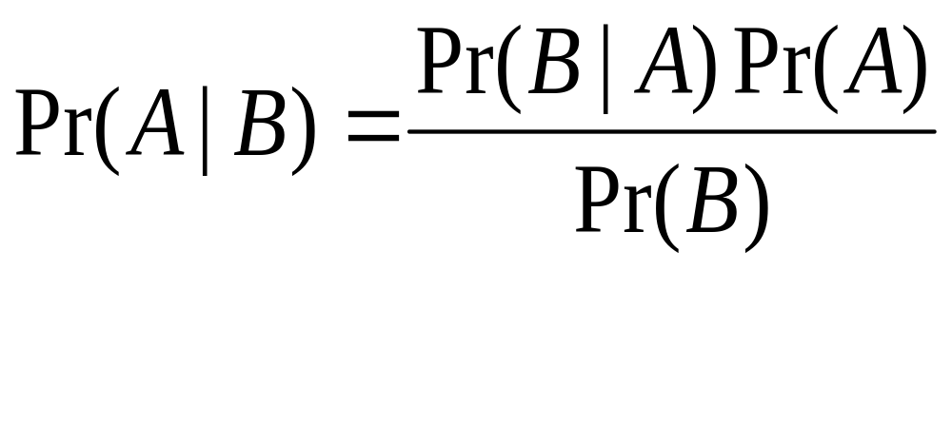
Bayes Theorem
Bayes' theorem relates the conditional and marginal probabilities of stochastic events A and B:
http://en.wikipedia.org/wiki/Bayes'_theorem

Slide 3
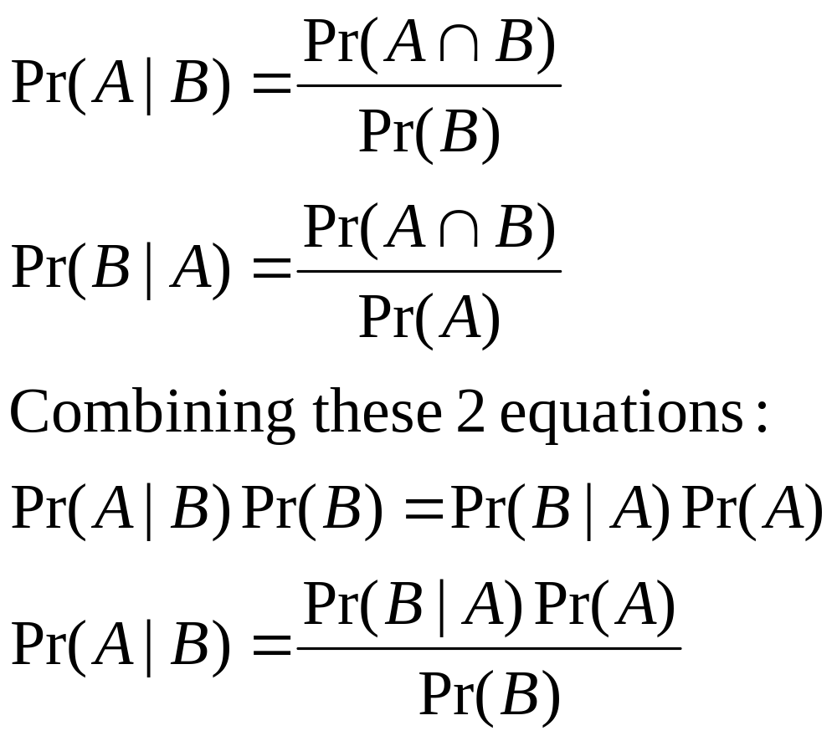
Derivation

Slide 4
Example
2 cookie bowls
  Bowl 1: 10 chocolate-chip, 30 plain
  Bowl 2: 20 chocolate-chip, 20 plain
Buck picks a plain cookie from one of the bowls, but which bowl?
Pr(A) = Bowl 1 = 0.5, 1 − Pr(A) = Bowl 2
Pr(B) = Plain cookie = 50/80 = 0.625
Pr(B|A) = 30/40 = 0.75
Pr(A|B) = 0.75 x 0.5/0.625 = 0.6

Slide 5
Components of Bayesian Inference
Prior Distribution – use probability to quantify uncertainty about unknown quantities (parameters)
Likelihood – relates all variables into a “full probability model”
Posterior Distribution – result of using data to update information about unknown quantities (parameters)

Slide 6
Bayesian inference
Prior information p(θ) on parameters θ
Likelihood of data given parameter values f(y| θ)

Slide 7
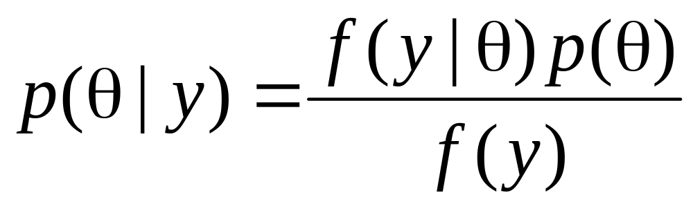
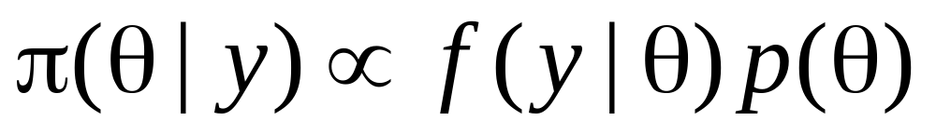
Bayesian inference
or
Posterior distribution is proportional to likelihood × prior distribution.

Slide 8
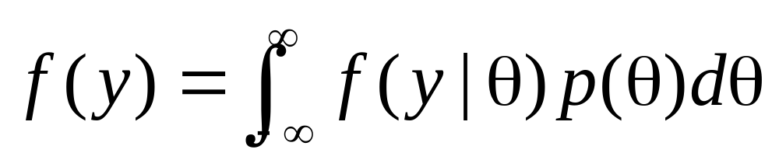
Bayesian inference
Not generally necessary to compute this integral.

Slide 9
Metropolis-Hastings
An algorithm that generates a sequence
{θ⁽⁰⁾, θ⁽¹⁾, θ⁽²⁾, …} from a Markov Chain whose stationary distribution is π(θ) (i.e., the posterior distribution)
Fast computers and recognition of this algorithm has allowed Bayesian estimation to develop.

Slide 10

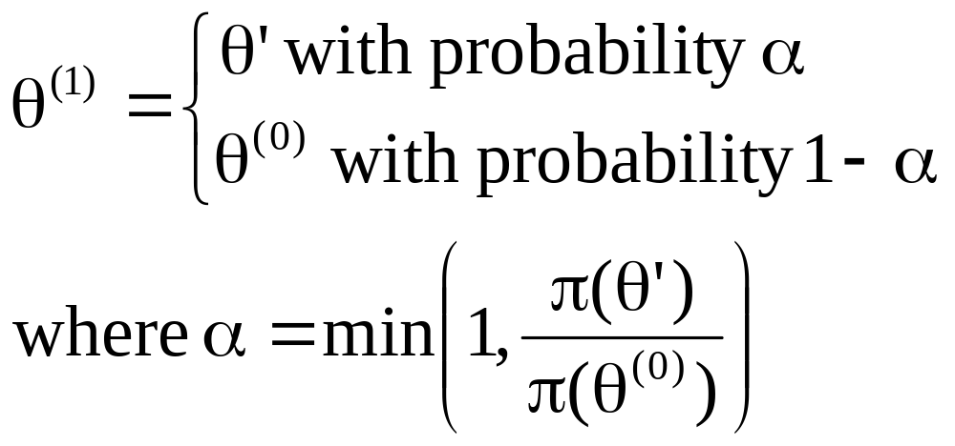
Metropolis-Hastings
Initial value θ⁽⁰⁾ to start the Markov Chain
Propose new value
Accepted value:

Slide 11
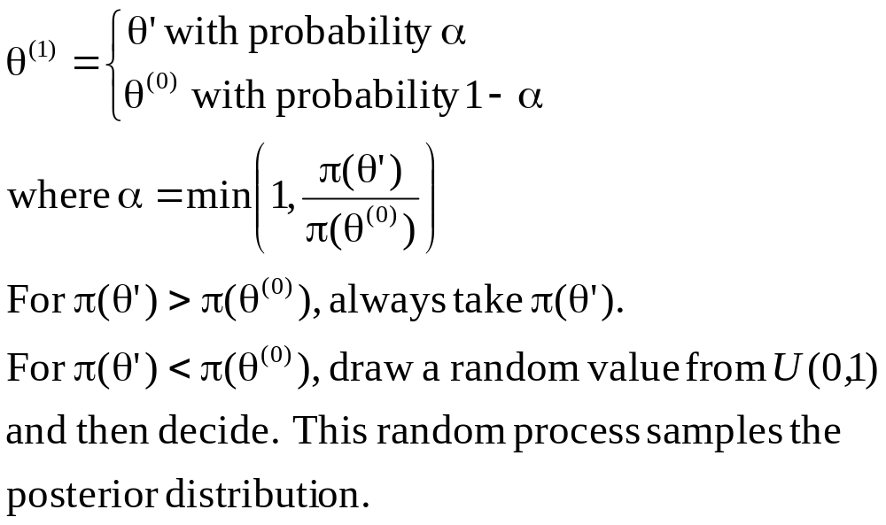
Metropolis-Hastings

Slide 12
MCMC
Markov Chain Monte Carlo
The sequence {θ⁽⁰⁾, θ⁽¹⁾, θ⁽²⁾, …} is a Markov chain, obtained through the Monte Carlo method, in MARK the Metropolis-Hastings method.

Slide 13
MARK – Defaults – Likelihood
Data type used to compute the model – same likelihood as is used to compute maximum likelihood estimates

Slide 14
MARK – Prior Distributions
Would be logical to use a U(0,1) distribution as the prior on the real scale
However, MARK estimates parameters on the beta scale, and transforms them to the real scale
Hence, the prior distribution has to be on the beta parameter.

Slide 15
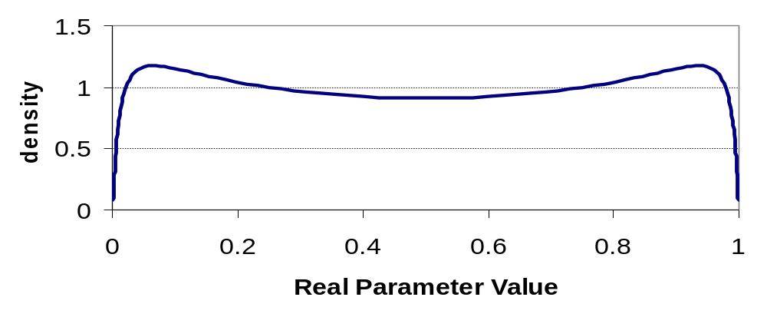
MARK – Defaults – Prior Distribution
For the beta parameters with logit link, normal with mean 0 and SD 1.75 = “uninformative” prior

Slide 16
MARK – Defaults – Proposal Distribution
Distribution used to propose new values
Normal distribution with mean 0 and SD estimated to give a 40–45% acceptance rate
That is, the SD is estimated during the “tuning” phase to accept the new proposal 40–45% of the time.

Slide 17
MARK Estimation Defaults
Tuning phase – 4000 iterations
Burn-in phase – 1000 iterations
Sampling phase – 10000 iterations

Slide 18
MARK – Posterior Summaries
Mean
Median
Mode
Percentiles
  2.5, 5, 10, 20, 50, 80, 90, 95, 97.5

Slide 19
MARK – Assessing Convergence
Multiple chains
  R statistic that compares variances within chains to between chains
Graphical evaluation
  Histograms
  Plots of chain

Slide 20
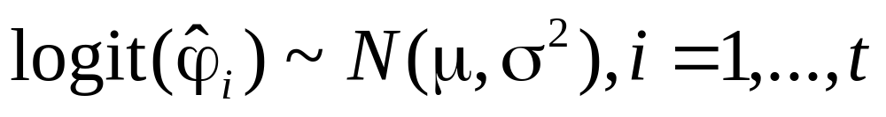
Hyperdistributions
Normal distribution from which a set of beta parameters on the logit scale are assumed to have been sampled
For example, annual survival rates where

Slide 21
Priors on hyperdistributions
Prior on μ ~ N(0, 100) “uninformative”
Prior on σ² ~ Inverse Gamma(0.001, 0.001)
i.e., 1/ σ² = τ ~ Gamma(0.001, 0.001)

Slide 22
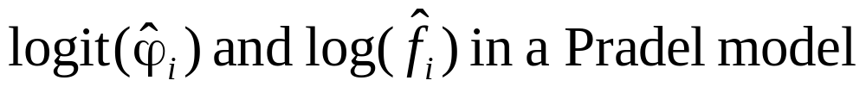
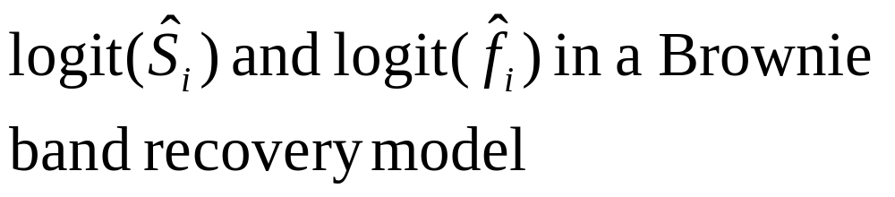
Multivariate Hyperdistributions
Joint distribution of 2 sets of parameters assumed to be multivariate normal, e.g.,
Prior on correlation Uniform(−1, 1)

